Slide 1



Market Knowledge
OPS Brown Bag
Confidential Property and Information
June 14, 2005

Slide 2
Agenda
Overview of MK Factory Architecture Darek Wisniewski
Overview of MK Organization Andrew London
  Responsibility / Ownership
Update on MK Program Andrew London
  Blackbird / Daily Data
  InfoScanMK Release 1.0
Update on MK OPS John Mark
Q & A

Slide 3
Overview of MK Factory Architecture

Slide 4
Architecture Goals
When complete, clients will realize:
  Faster Speed of Delivery
  Improved Data Quality
  Greater Flexibility (Dimension Manipulation and Views)
  Easier Access
  Standardized Integration Approaches
  Unified, Global Processing
  On-Demand Analytic Capabilities
  Extensibility to New Industries
  Reduced Time-to Market for New Services

Slide 5
Major Objectives
Integrate all data sources
  Make all data available in all applications and interfaces
  Integrate with customer data sources
Build a world-class flexible dimension management system
  Fix RMA/CRMA/Restatement issues
  Create flexible product dictionary
  Replace STUB processing
  Handle all IRI dimensions in a common format
Common access to all IRI data
Bring up new products/services within 3 months
Push into new markets
  FSP, Daily Data, Health, New Country Expansion, others
        Support rapid custom deliverable creation
        New revenue opportunities
Improved and integrated user interfaces & application
Drastically reduce costs

Slide 6
Architecture Solution Components
The architecture will combine elements of IRI, Acxiom and third party technologies. It is broken up into several discrete components:
Data Transfer Manager: Landing and processing data from our data partners - based initially on existing IRI capabilities and migrating to Acxiom DTM tool suite
Data Cleansing and Scrubbing: Managing the data quality process and loading the data into the central data warehouse - based on Ascential DataStage technology
Rules Engine: Handling business, QC and process rules that control various factory components (e.g. quality control, releasibility, etc.) – based on ILOG’s JRULES technology

Slide 7
Architecture Solution Components
Factory Data Warehouse: Holding both main fact databases, and various dimension and operational data stores – based on a hybrid RDBMS for greater flexibility and Acxiom’s file processing grid to enable faster access to data
Order Management System: A configuration based system to manage new product definitions and customer requirements against Market Knowledge deliverables - based on Selectica’s technology
Dimension Maintenance: A single framework for managing all of IRI dimensions including client specific definitions- based on Java front end and managed in an Oracle RDBMS and leveraging ILOG’s rules engine to manage business rules

Slide 8
Architecture Solution Components
Metadata Management System: Capturing application meta-data as well as audit and lineage data used for managing the data investigations process - based on Ascential’s MetaStage technology and the Acxiom meta-data tool suite
DataMart Creation: Creating data marts in a fast, cost efficient and easy to configure manner – based on custom technology developed to leverage Ascential DataStage for handing the job runtime in the grid environment and custom code to manage complex aggregations
Grid implementation: Handling both data mart construction and file data processing not housed in an RDBMS – leverage Acxiom grid technologies

Slide 9
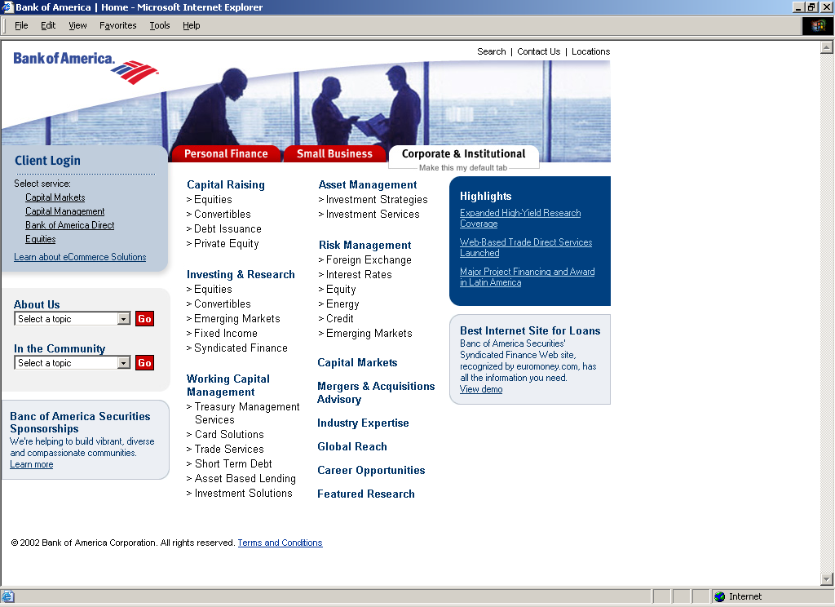
Market Knowledge Architecture Software mapped to functional components
Order
OMS
Messaging
JMS
APIARY
APIARY
CONFIGURATOR (ILOG)
CONFIGURATOR (ILOG)
D
a
t
a
M
a
r
t
s
VI-DI
SCHEDULING & OPTIMIZATION
(NEXUS & ORBITOR)
SCHEDULING & OPTIMIZATION
(NEXUS & ORBITOR)
DCA
ASI
META
STAGE
DATA
STAGE
META
STAGE
DATA
STAGE
DTM
DCS
Factory Data
Warehouse
ORACLE
FEE
IRI APPS
DTM
ENIGMA
RULES (ILOG)
RULES (ILOG)
Data Lineage Custom Application
Data Lineage Custom Application
Processing Grid
Processing Grid
IRI Platform Grid
FILES
ACXIOM Data Grid File Manager (DGFM)
Data Files
Data Lineage Custom Application
Data Grid
Metadata METASTAGE
Operational
Order
Rules
Configuration
Acxiom
Other
IRI APPS
Operational Data Stores ORACLE
Attributes
Orders
Dimensional
Measures
Audit
Instrumentation
Services
J2EE & .NET Web Services
Java Beans & .NET Framework

Slide 10






Existing Data Flow
Mainframe
Data
Marts
OLAP
Visualization
End Users
Selector
Nearly
100% Custom Code…
MSAS
RPM
AS
BPM
UPC..
Office
Viewer
Retailers
Data
Warehouse
DCS
Custom
DTM
Custom

Slide 11
New Data Flow
Core Factory
Data
Marts
OLAP
Visualization
End Users
Selector
OMS
DMS
MMS
MSAS
RPM
BRMS
AS
DMC
AS
BPM
FDW
…
…
UPC..
Office
Viewer
Evolution…
Retailers
Data
Warehouse
DCS
DTM

Slide 12
Overview of MK Organization

Slide 13
MK Steering Committee
Marshall
Prod.
Mgmt.
PMO
QA
Bus.
Arch.
Process
Eng.
Prod.
Dev.
Eng.

Slide 14
MK PMO – Work Structure
Marshall
Brad W.
Tom P.
Andrew
John M.
MFR
Andrew
Sharon
Rachel
Martin
New Hire
Vivek
Lori B.
Alex
Martin
Vivek
ITO
MFR
(SAS)
Bus.
Plng.
DMS
RPM
Info
Scan
Daily
Data
DMC
OMS
SSO
MK
PAO
Data
Ctr.
Prod.
Mgmt.
MMS
Plus
Suite
FDW
All…
Re-eng
JETS
Office
Viewer
DCS
DIV
AS
BRMS
Components
Products
Process Re-eng.
Other
Acxiom Grid

Slide 15
MK QA – Work Structure
Marshall
Tom E
Perform/Auto
Test
Process
&
Tools
US QA
MK QA
Gayatri
Huma
Maria
Oleg
Ruth
Thomas
Mike K
Eric
Dan
Mike K
Luda
Peter
Ismael
Jeff

Slide 16
MK SE – Work Structure
Marshall
Ed
Darek
Shub
Jeff W.
Satish
Jim R.
Jeff B.
DMC.
FDW
FDW
Relational
OMS
DMS
Venue
Infra.
Arch.
Visual
DMS.
MMS
DMS
Product
JETS
BRMS
DIV
Acxiom Grid

Slide 17
MK Bus. Arch – Work Structure
Marshall
Jeanne
Bus. Arch
Prod. Dev.
User Exp.
Reqs.
Cathy D
Damian
Sarah
Claire
Jeanne
B.
Kathy K
Cathy H
Jim
Michael
Adam

Slide 18
Update on MK Program

Slide 19
MK All Projects (High-level Plan)
 | Owner | Acxiom? | May | Jun | Jul | Aug | Sep | Oct | Nov | Dec | Jan ‘06 | Feb’06 | Mar ‘06 | 2Q 06 | 3Q06 | 4Q06
Products
InfoScan MK Release V1R0 (GA) | Terese H. | Yes |  |  |  |  |  |  |  |  |  |  | 4/1
Daily Data | Jeanne L. | Yes |  |  |  |  |  | 10/31
Plus Suite | Jeff O. |  |  |  |  |  |  |  | 11/15
RPM | Jeff O. |  |  |  |  | 8/31
AS | Jeff O. |  |  |  |  | 8/31
New Country Expansion | Helen S. |  |  |  |  |  |  |  |  |  | 2/1
Mainframe Retirement (MFR) | Tom P. | Yes
Process Re-engineering | John M. |  |  |  |  |  |  |  |  |  |  |  | 3/31
Data Integrity | TBD |  |  |  |  |  |  |  |  |  |  | 2/28
Customer Migration | Terese H.
InfoView QS3 Replacement
Today

Slide 20
MK Products/Services (Iterations)
(*Note: Plan requires validation with detail project plans associated with Use Case/Design outcomes - early June)
 | Owner | Acxiom? | May | Jun | Jul | Aug | Sep | Oct | Nov | Dec | Jan ‘06 | Feb’06 | Mar ‘06 | 2Q 06 | 3Q06 | 4Q06
InfoScan MK Release V1R0 | Terese H.
Market Positioning/Pricing | Terese H.
Iteration One | Rachel T. | Yes |  |  | 8/1
Iteration Two | Rachel T. | Yes |  |  |  |  | 10/1
Iteration Three | Rachel T. | Yes |  |  |  |  |  |  | 12/1
Iteration Four | Rachel T. | Yes |  |  |  |  |  |  |  |  | 2/1
Iteration Five (GA) | Rachel T. | Yes |  |  |  |  |  |  |  |  |  |  | 4/1
Commercialization | Elisa G.
Daily Data | Jeanne L.
V3R0 | Alex M. | Yes |  | 6/30
V3R1 | Alex M. | Yes |  |  | 7/31
V3R2 | Alex M. | Yes |  |  |  |  |  | 10/31
Plus Suite | Jeff O.
V2R0 | Lori B.
Ext. Pilot (Avail. for CRX ACN clients) | Lori B. |  |  | 6/15
V2R1 | Lori B.
Web Selector | Lori B. |  |  |  | 7/29
V2R2 | Lori B. |  |  |  |  |  |  |  | 11/15
Web Selector | Lori B. |  |  |  |  |  |  |  | 11/15
RPM
Magellan | Lori B. |  |  |  |  | 8/31
AS
Mustang | Lori B. |  |  |  |  | 8/31
New Country Expansion | Helen S. |  |  |  |  |  |  |  |  |  | 2/1
Today

Slide 21
Daily Data

Slide 22

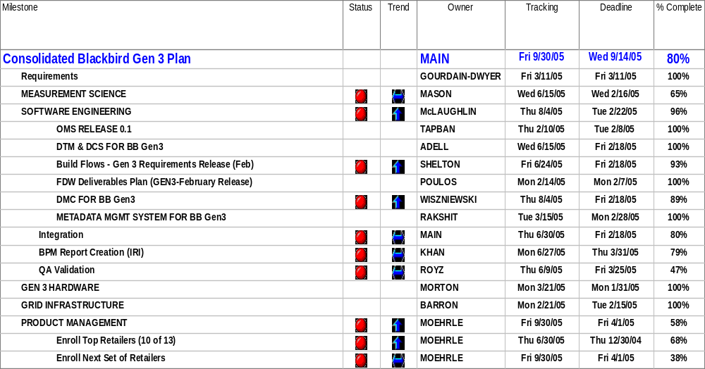
Daily Data - Gen3
Updated on: 02-14-2005
Project: Blackbird Gen3
Program Manager: Alex Main
R
Milestone well behind schedule or work stoppage
Y
Milestone falling behind schedule, no work stoppage
G
Milestone tracking to plan, no work stoppage

Slide 23
Daily Data – Gen3
Project: Blackbird Gen3
Program Manager: Alex Main
Updated on: 06-06-2005
Accomplishments
Completed OOS Beta and k development; final unit testing and validation in progress
Continued DCS and DMC defect resolution
  Closed high percentage of open defects
Continued QA and Integration testing
Completed PROD environment set-up and smoke testing
Completed 3 week data load for all Retailers; restarted QA test runs
Completed running Production baselines & 3 months of Brookshire backdata
Continued processing backdata in the Production environment for Albertsons, Food Lion and Walgreen’s
Corrective Measures
DCS: Continue DCS defects fixes and integration testing
  Complete OOS Beta & k validation by 6/15
  Complete development of newly identified pvalue defect by 6/6
DMC: Turn over PM harvester files with Pvalue fix by 6/6
OMS: Resolve remaining open critical defects by 6/15
QA: Complete all QA testing by 6/30
Integration: Complete all integration testing by 6/30
R
Milestone well behind schedule or work stoppage
G
Milestone tracking to plan, no work stoppage

Slide 24
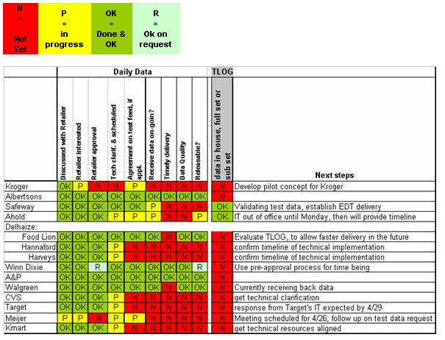
Daily Data Release

Slide 25
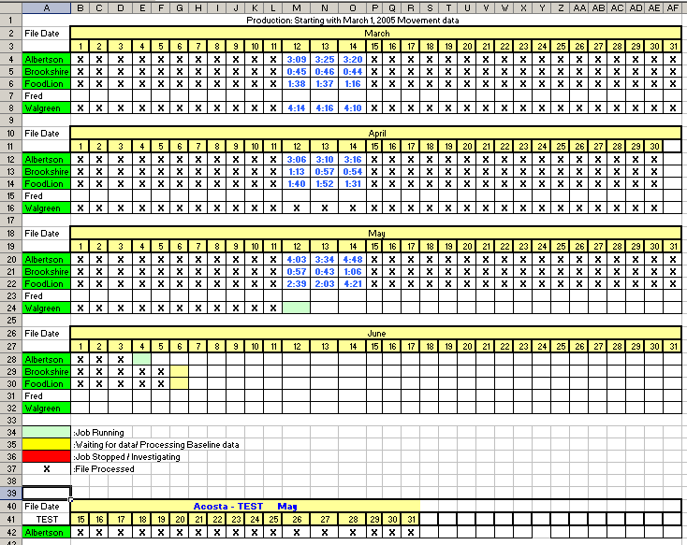
Production Status

Slide 26
InfoscanMK Release 1.0

Slide 27
InfoScan MK Outcomes
June-July Iteration 1 | Aug-Sept Iteration 2 | Oct-Nov Iteration 3 | Dec-Jan Iteration 4 | Feb-Mar Iteration 5
Geography Definition and versioning (Internally view new and old geography defs with same name) | Rapid Geography Redefinition - new venue group created; projected and releasibility validated | CRX data loaded in FDW | CRX delivered in a datamart | Defect Fixes
Ability to place an order (Internal Test of flow, no output) | Support Releasibility rules – user will not be able to select dimensions that are not releasable based on rules | Unbundle – see a datamart with bundled and unbundled UPCs | Recode/Special Pack – process 3 special pack categories with a data subset | Re-factoring
Multiple Hierarchy Prototype: Define Multiple Hierarchies Multiple Volume Equiv More than 9 levels Longer Desc. Create Rule based attribute Create datamart from specifications | Automate QC & exception process mgt Create and view panel orders | Improved Baseline and multiple baselines – compare old and new Pvt Label Tiers Major Brand | Frito Reclass – process Salty Snacks category for Frito with a data subset IPF & NBD panel weighting TRV panel weighting Panel DataMart available | Training
Availability of Product Catalog (populated catalog for review) | Define Selective Restatement and re-runs (manual trigger required) – perform 1 selective restatement on geography and 1 selective restatement on product | Run selective restatement – compare old to new data – use case defined in It 2 | Full measure set available and new measures available Standard Panel Measures available | Productionization
Visibility of work order & scheduling | Product Gap Features – headroom for other items currently not known | POS Geographies available for delivery through a datamart with 12 weeks of data – need 1 from each outlet type & subset of measures | POS Geographies available for delivery through a datamart with 2 ¼ years and all measures | Operationalizing – run throughs
 |  | Multiple Hierarchies final production version for testing | Panel, TRV, CRX & Store data available in the same report | Premium Measures available (incrementality)
 |  | Availability of prioritized Certified Measure set
 |  | Create geography (venue groups) using rules-based attributes

Slide 28
InfoScan MK V1R0
End Date | Outcome | Product Feature Description | Top Risks & Confidence
June 8 | Iteration 1 Requirements Complete |  | Clear Process Acxiom Alignment Confidence = High
July 31 Iteration 1 | Proof of Concept | Define and deliver Multiple Product Hierarchies Define and deliver multiple volume equiv Define and deliver more than 9 level hierarchy Create product attributes from rules Place an order – no output/workflow only | Blackbird containment DCS, OMS, DMS Resource Ramp Up before June Acxiom Alignment & Iterative Design Framework completion Trevor Mason availability Confidence = High
Sept 30 Iteration 2 | Proof of Concept | New venue group created, projected and releasibility validated (Rapid Redefinition) | AR&D plan Confidence = Medium
Nov 31 Iteration 3 | Proof of Concept Internal Pilot | Perform selective restatements and compare to previous (Rapid Redefinition) Create venue group using attributes from rules Create datamart of Pilot scale with 12 weeks of data (excluding CRX & Panel) | Mainframe Migration dependency Confidence = Low
Jan 31 Iteration 4 | Client Pilot | CRX available in datamart Panel Purchase Trends available in datamart TRV available in datamart Create datamart for Pilot with 2 ¼ years of data | Confidence =
Mar 31 Iteration 5 | Ver 1.0 GA | Operational & Productionized Premium measures available | Confidence =

Slide 29
InfoScan MK V1R0 (Iteration Plan)
(*Note: Plan requires validation with detail project plans associated with Use Case/Design outcomes - early June)
 | Owner | Acxiom? | May | Jun | Jul | Aug | Sep | Oct | Nov | Dec | Jan ‘06 | Feb’06 | Mar ‘06 | 2Q 06 | 3Q06 | 4Q06
Iteration One | Rachel T.
Requirements | Jeanne L.
Feature development (prioritization) | Terese H.
Preparation (ReqPro, etc.) | Claire G.
*Project Iteration plan builds | Rachel T. | Yes |  | 6/8
Resource plan | Rachel T. | Yes |  | 6/8
Use Case Authoring | Claire G. |  |  | 6/8
Use Case Reviews | Claire G. | Yes |  | 6/15
Use Case Approvals | Claire G. | Yes |  | 6/16
Analysis | Ed M. | Yes |  |  | 7/5
Design (based on Use Case) | Ed M. | Yes
Feature | Ed M. | Yes
Specific functions of feature | Ed M. | Yes
Development plan (code, test) | PMO | Yes
Iteration complete |  |  |  |  | 7/31
Iteration Two | Rachel T.
Requirements | Jeanne L.
Feature development (prioritization) | Terese H. |  |  | 6/30
Preparation (ReqPro, etc.) | Claire G. |  |  | 6/30
Use Case Authoring | Claire G. |  |  |  | 7/8
Use Case Reviews | Claire G. | Yes |  |  | 7/15
Use Case Approvals | Claire G. | Yes |  |  | 7/22
Project Iteration plan builds | Rachel T. |  |  |  | 7/31
( Iteration repeats as per above*) | Rachel T. |  |  |  |  |  | 10/1
Commercialization | Terese H. |  |  |  |  |  |  |  |  |  | 2/1

Slide 30
Update on MK OPS

Slide 31
Global Process Design Team
Michelle Hanson*
Offer
Product
Provide
Content
Analytics/
Insights
Provide
Solutions
TBN
Jonah Ellin*
Marc
von Ommen
Herve
Tempelaere*
Frank Bolker*
Define
Product
Place
Order
Collect
Data
Check
&Load
Manage
Venue
Dimensions
Manage
Product
Dimensions
Process &
Deliver
CPGN
DoD
Svc/Ops
Check and Support
IT Support
Belzile
This Team is Linked to the Infoscan MK Core Team

Slide 32
The Release Process
Product Management
Product
Specification
Product Spec
Client
Migration
Migration Plan
Process
Engineering
Business
Requirements
Features
IRI
Change
Management
Change Plan
Iteration
Plan
Development
Iteration
Plan
Accepted
Code
AD
Technical
Requirements
Use Cases

Slide 33






Flow to Production
Walkthrough
Product Features
Product Release
and Business Rules
Demonstration
of the Product
High-Level Process and Data Flow
(End-to-End) with FMEA
Detailed Process and Data Flow
BPMS (to include each module)
Explain how Process Steps in the
SOPs are related to the detailed Process Flows
Support Tools & Training/Documentation
(JETS User Guide / Tips and Tricks)
Organization Chart & Capacity Plan
All of the above will result in MK PAO creating effective
SOPs, SLAs, Problem Resolution Support Model, Change Management Process

Slide 34
Q & A

